Slide 1
Identifying Insurance Claim Frauds Detection using Machine Learning Technique

Slide 2
ABSTRACT
Insurance Company working as commercial enterprise from last few years has been experiencing fraud cases for all type of claims. Amount claimed by fraudulent is significantly huge that may cause serious problems, hence along with government, different organization also working to detect and reduce such activities. Such frauds occurred in all areas of insurance claim with high severity such as insurance claimed towards auto sector is fraud that widely claimed and prominent type, which can be done by fake accident claim. So, we aim to develop a project that work on insurance claim data set to detect fraud and fake claims amount. The project implements machine learning algorithms to build model to label and classify claim. Also, to study comparative study of all machine learning algorithms used for classification using confusion matrix in term soft accuracy, precision, recall etc. For fraudulent transaction validation, machine learning model is built using PySpark Python Library.

Slide 3
INTRODUCTION
The insurance industries consist of more than thousand companies in worldwide. And collect more than one trillions of dollars premiums in each year. The vehicle insurance fraud is the most prominent type of insurance fraud, which can be done by fake accident claim. In this project, focusing on detecting the vehicle fraud by using, machine learning techniques.
Fraud is one of the largest and most well-known problems that insurers face. Fraudulent claims can be highly expensive for each insurer. Therefore, it is important to know which claims are correct and which are not.
Ideally, an insurance agent would have the capacity to investigate each case and conclude whether it is genuine or not. However, this process is not only time consuming, but costly. Sourcing and funding the skilled labor required to review each of the thousands of claims that are filed a day is simply unfeasible.
This is where machine learning comes in to save the day. Once the proper data is fed to the system it'll be very easy to find out if the claim is genuine or not.

Slide 4
INTRODUCTION TO MACHINE LEARNING
Machine Learning is said as a subset of Artificial intelligence that is mainly concerned with the development of algorithms which allow a computer to learn from the data and past experiences on their own.
Machine learning uses data to detect various patterns in a given dataset.
It can learn from past data and improve automatically.
Machine learning is much similar to data mining as it also deals with the huge amount of the data.

Slide 5
OBJECTIVE OF THE PROJECT
To creating a model that can accurately anticipate which transactions might be fraudulent.
To build a classification methodology using machine learning technique to determine whether a customer is placing a fraudulent insurance claim by using historical data
To determine if a claim for insurance is legitimate or not.
To assess the effectiveness of the fraud detection algorithm

Slide 6
PROBLEM STATEMENT
Inability to perceive the context-specific relationships between the parameters (geography, client section, insurance sales process) which may not mirror the typical picture.
Constrained to control with the restricted set of not able parameters supported the heuristic knowledge – where, as being aware that a number of the opposite attributes might conjointly influence the decisions.
Reconstruction of the given model is that the hand operated exercise that need to be conducted sporadically to react dynamic behavior. Also, to make sure that the model gives feedback from the examinations. The flexibility to manage this standardization is tougher.
Incidence of occurrence of fraud is low - generally but1percent of claims area unit classified.
Consultations with business specialists point out that there is not a typical model to determine the model exactly similar to the context

Slide 7
LITERATURE REVIEW
S. NO | TITLE | AUTHOR NAME | DESCRIPTION
1 | Prediction of insurance fraud detection using machine learning algorithms | Laiqa Rukhsar; Waqas Haider Bangyal; Kashif Nisar; Sana Nisar | People are trending to invest in such kinds of insurance, which helps the scam artist to cheat them. Insurance fraud is a prohibited act either by the client or vendor of the insurance contract. Insurance fraud from the client side is encountered in the form of overestimated claims and post-dated policies etc. Although, insurance fraud from the vendor side is experienced in the form of policies from non-existent companies and failuew to submit premiums and so on.

Slide 8
S. NO | TITLE | AUTHOR NAME | DESCRIPTION
2 | An intelligent unsupervised technique for fraud detection in health care systems | Kanksha, Bhaskar, Aman Pande, Sagar Malik, Rahul Khamparia, Aditya | Claims fraud is a significant contributor to increased healthcare expenses, though the effect of it could be lessened by fraud detection. In this paper, an analysis of various machine learning techniques was done to identify Medicare fraud. The isolated forest an unsupervised machine learning algorithm which improves overall performance while detecting fraud based upon outliers.

Slide 9
S. NO | TITLE | AUTHOR NAME | DESCRIPTION
3 | A Comparative Study of Using Various Machine Learning and Deep Learning-Based Fraud Detection Models For Universal Health Coverage Schemes | Rohan Yashraj Gupta, Satya Sai Mudigonda, Pallav Kumar Baruah | Data imbalance: skewed number of lesser fraudulent cases in comparison to the non-fraudulent cases, Selection of classification model: use of appropriate machine learning or deep learning models to identify fraud or non-fraud cases

Slide 10
EXISTING WORK
People are trending to invest in such kinds of insurance, which helps the scam artist to cheat them. Insurance fraud is a prohibited act either by the client or vendor of the insurance contract. Insurance fraud from the client side is encountered in the form of overestimated claims and post-dated policies etc.
Data processing a neighborhood of machine learning has advanced considerably within the current years. Data mining focuses at analyzing the whole data obtained.
On the contrary, within the different of getting the knowledge for world understanding is within the processing applications like machine learning, it uses the knowledge to locate patterns in information and improvise the program actions.

Slide 11
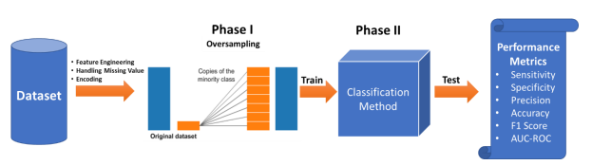
EXISTING BLOCK ARCHITECTURE

Slide 12
PROPOSED WORK
The dataset is gathered and cleaned before several models are tried on it. Several features of the model are engineered and evaluated again based on the original model performance.
Once all the options have been created, the model is created and run using entirely different entirely different values and entirely different entirely different iteration processes.
It is possible to determine whether an insurance claim is false by using a prediction model. The classification system used to identify fraudulent transactions is the subject of this report.
The effectiveness of the algorithms are observed on the basis of performance metrics: Precision, Recall and F1-Score. The comparative results of classification algorithms conclude that DT gives the highest accuracy of 79% as compared to the other techniques.

Slide 13
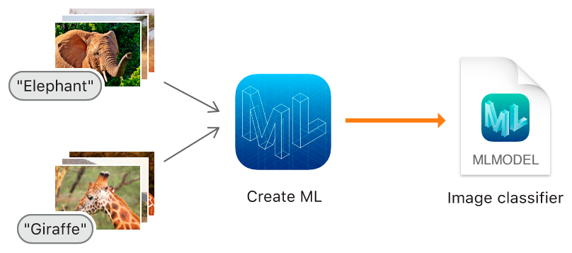
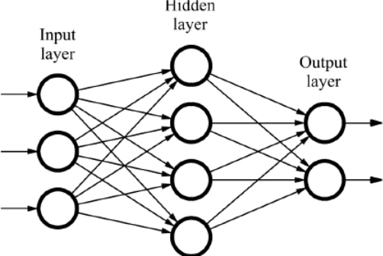

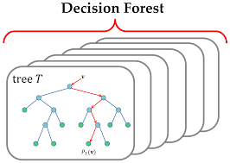
PROPOSED SYSTEM ARCHITECTURE
Input Dataset
Feature Selection
Classifiers
Evaluation
Data set Collection
Fraud Claim
Feature Set
Classifiers
RF
LR
No Fraud Claim

Slide 14
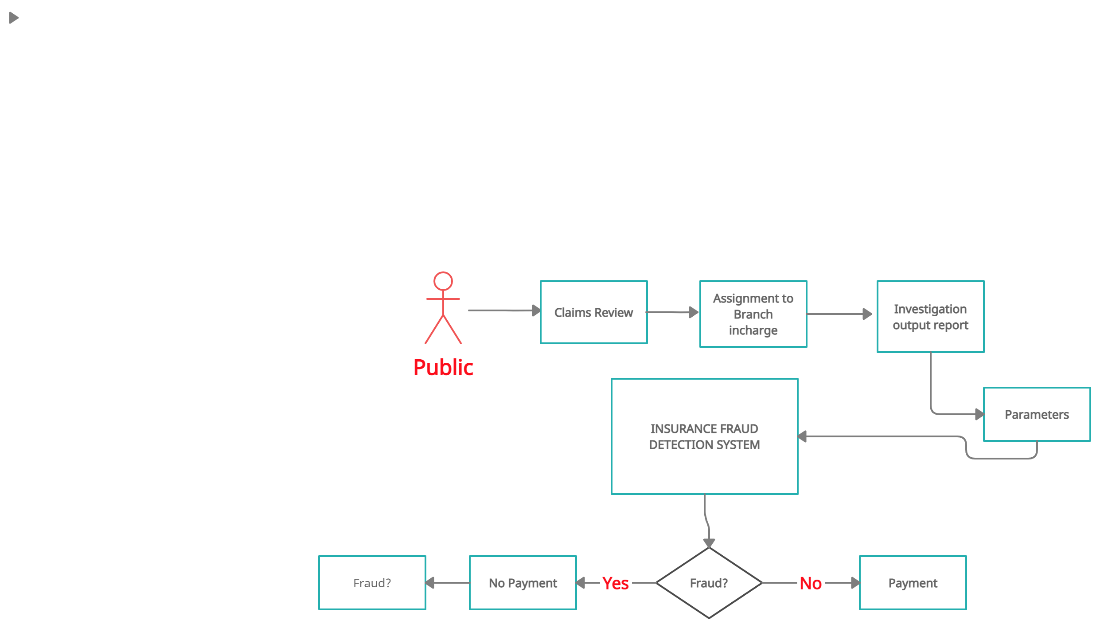
OVERALL SYSTEM FLOW

Slide 15
METHODOLOGY
Machine learning algorithms required for this project
1. Random Forest
2. Logistic Regression

Slide 16
ALGORITHM / MODEL USED
Random Forest Classifier
The random forest randomly selects the features that is independent variables and also randomly selects the rows by row sampling and the number of decision tree can be determined by using hyper parameter optimization. For classification problem statement the output is the maximum occurrence outputs from each decision tree models inside the random forest. This is one the widely used machine learning algorithm in real word scenarios and in deployed models. And in most of the Kaggle computation challenges this algorithm is used to solve the problem statement.

Slide 17
ALGORITHM / MODEL USED
Logistic Regression Classifier
Logistic regression works with sigmoid function because the sigmoid function can be used to classify the output that is dependent feature, and it uses the probability for classification of the dependent feature.

Slide 18
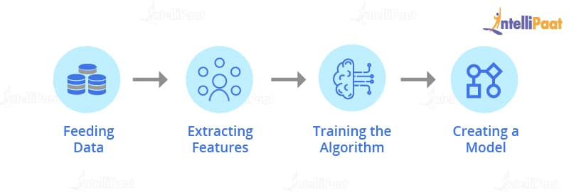
MODULES
Training Module
Data Collection
Data pre-processing
Model Training
Testing Module
Login
Prediction
Deployment in Cloud

Slide 19
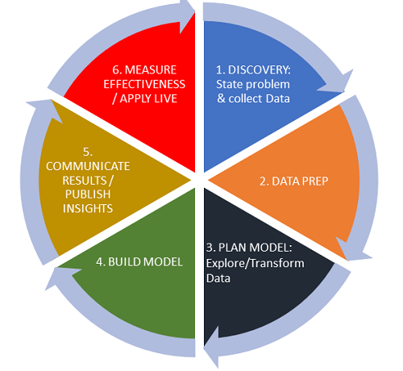
TRAINING MODULE
1. Data Collection & Validation
2. Data Pre-processing
3. Model Training

Slide 20
TESTING MODULE
4. Login
5. Prediction
6. Deployment in cloud platform as webapp

Slide 21
SYSTEM REQUIREMENTS
The requirement specification is a technical specification of requirements for the software products. It is the first step in the requirements analysis process it lists the requirements of a particular software system including functional, performance and security requirements. The requirements also provide usage scenarios from a user, an operational and an administrative perspective.
HARDWARE REQUIREMENTS:
System : Pentium i3 Processor.
Hard Disk : 500 GB.
Monitor : 15’’ LED
Input Devices : Keyboard, Mouse
Ram : 4 GB
SOFTWARE REQUIREMENTS:
Operating system : Windows 10.
Coding Language : Python 3.8
Web Framework : Flask

Slide 22
Proposed Block Diagram
Dataset
Data
Pre-processing
Test
Test
Model Classification
Fraud detection

Slide 23

Use Case Diagram
Data Collection
User
Pre-Processing
Fraud Claim
Insurance Fraud detection
No Fraud Claim

Slide 24
DFD Level – 0 Diagram
Dataset
Pre-Processing
Classification
Evaluation

Slide 25
DFD Level – 1 Diagram
Login Page
Fraud Claim
Dataset Collection
Classification
Evaluation
No Fraud Claim
Signup Page

Slide 26
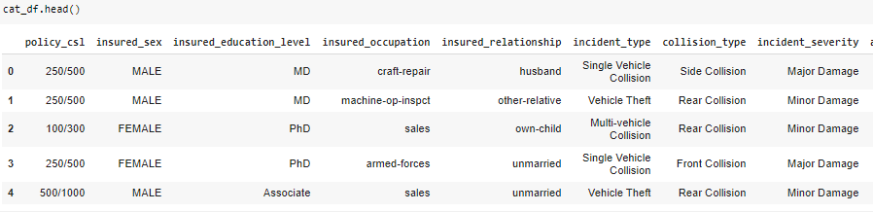
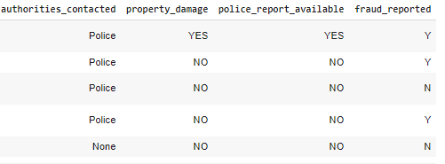
MODULES IMPLEMENTED- DATA COLLECTION

Slide 27
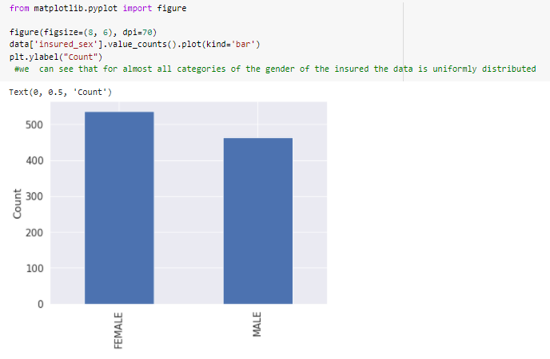
MODULES IMPLEMENTED- DATA COLLECTION
We can see that for almost all categories of the gender of the insured the data is uniformly distributed

Slide 28
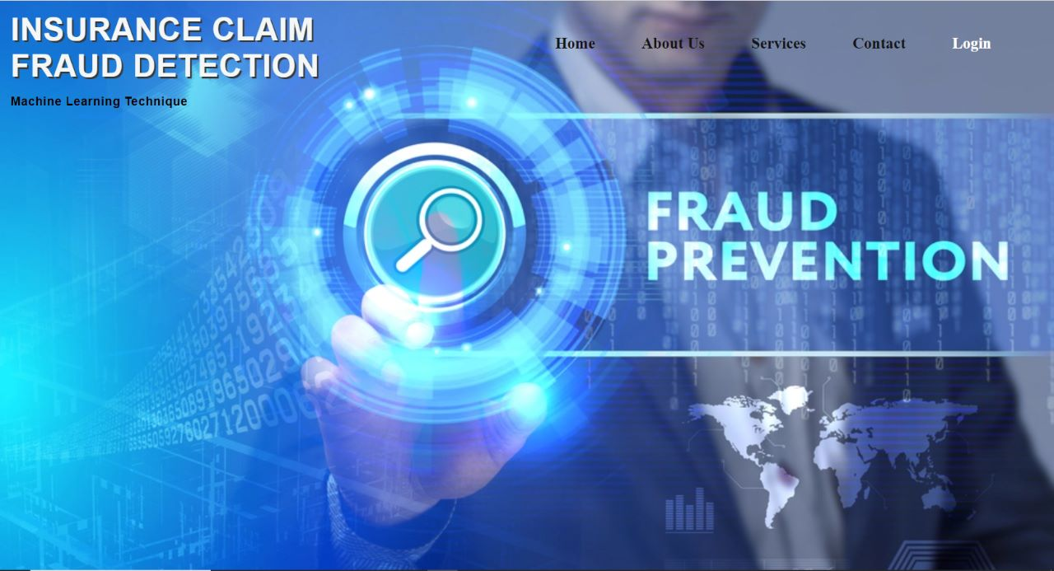
MODULES IMPLEMENTED

Slide 29
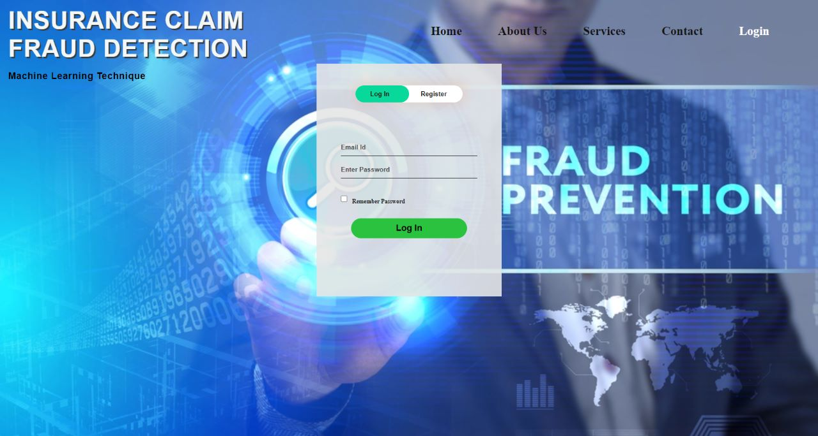
MODULES IMPLEMENTED

Slide 30
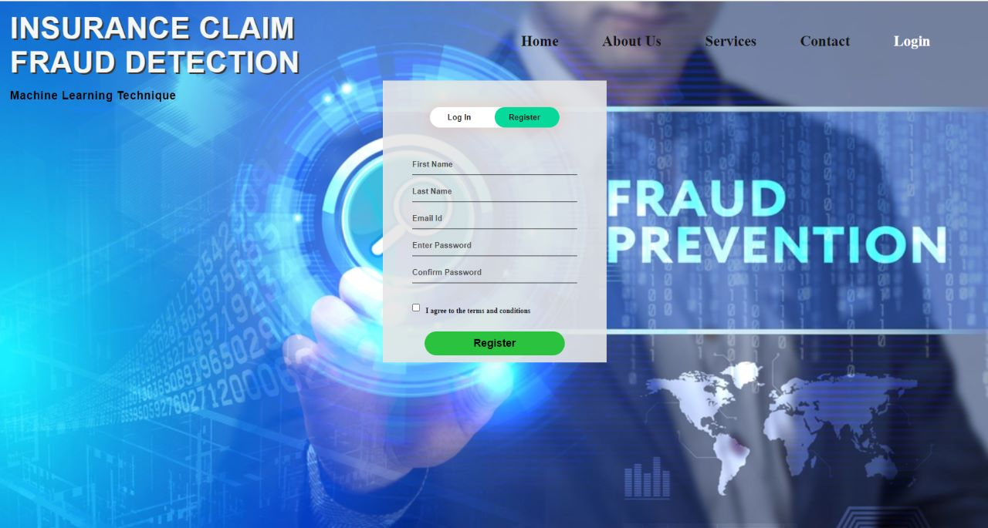
MODULES IMPLEMENTED

Slide 31
REFERENCES
Bhaskar A, Pande S, Malik R, Khamparia A. An intelligent unsupervised technique for fraud detection in health care systems. Intelligent Decision Technologies. 2021 Jan 1;15(1):127-39.
Sathya M, Balakumar B. Insurance Fraud Detection Using Novel Machine Learning Technique. International Journal of Intelligent Systems and Applications in Engineering. 2022 Oct 1;10(3):374-81.
Rukhsar L, Bangyal WH, Nisar K, Nisar S. Prediction of insurance fraud detection using machine learning algorithms. Mehran University Research Journal of Engineering & Technology. 2022 Jan 1;41(1):33-40.
Zhou X, Cheng S, Zhu M, Guo C, Zhou S, Xu P, Xue Z, Zhang W. A state of the art survey of data mining-based fraud detection and credit scoring. InMATEC Web of Conferences 2018 (Vol. 189, p. 03002). EDP Sciences.
Asgarian A, Saha R, Jakubovitz D, Peyre J. AutoFraudNet: A Multimodal Network to Detect Fraud in the Auto Insurance Industry. arXiv preprint arXiv:2301.07526. 2023 Jan 15.

